Slide 1

ENGLISH PREMIER LEAGUE DATABASE MANAGEMENT
Presented By Group 15-
Naman Gupta- 002142933
Sharvika Barapatre- 002192964
Kumari Puja- 002100985
Yash Navadiya- 002193912
Prasanna Nimbalkar- 002111122
Notes:
NOTE: Want a different image on this slide? Select the picture and delete it. Now click the Pictures icon in the placeholder to insert your own image.

Slide 2

Objective
Centralized database that will have data of all the teams, players, coaches, matches, sponsors, team owners which will be accessible to every major entity who are related to the league.
To design a system for team owners to choose players for their team and sponsors to select a team they want to associate with.
Easily view the record of matches played and check the performance of each team and team player in the league.
Post a goal in a match whenever a goal is scored to keep a record.
Create prototype which can be a baseline for a full-fledged working league database.
Analyze the data for a league and each match to create visualizations possible.

Slide 3
Design Summary
14 entities have been created and relationships have been established in normalized form suited for database.
Attachment of Design document with the entities, attributes and description of each entity.

Slide 4
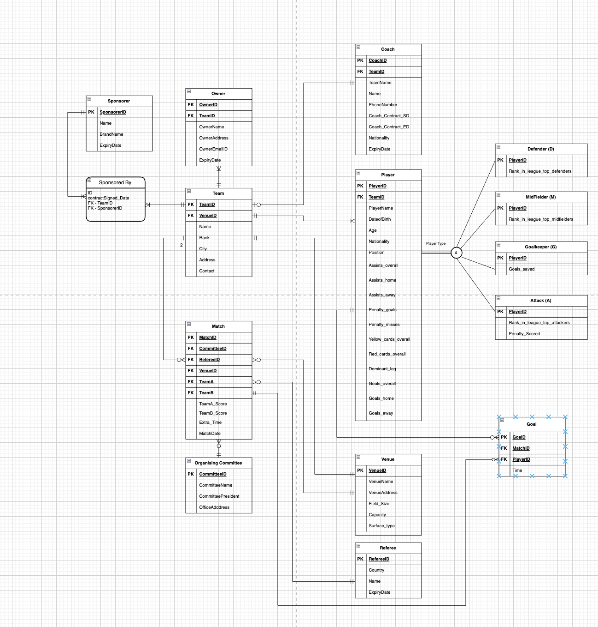
Final ERD

Slide 5
14 tables created. Insert scripts provided in the attached link.DDL
SQL statement

Slide 6
Database Objects
1. Stored Procedure
2. Constraints
3. Encryption
4. Functions
5. Views
6. Triggers
7. Visualization

Slide 7
Thank You !!!!!!!

